Slide 1
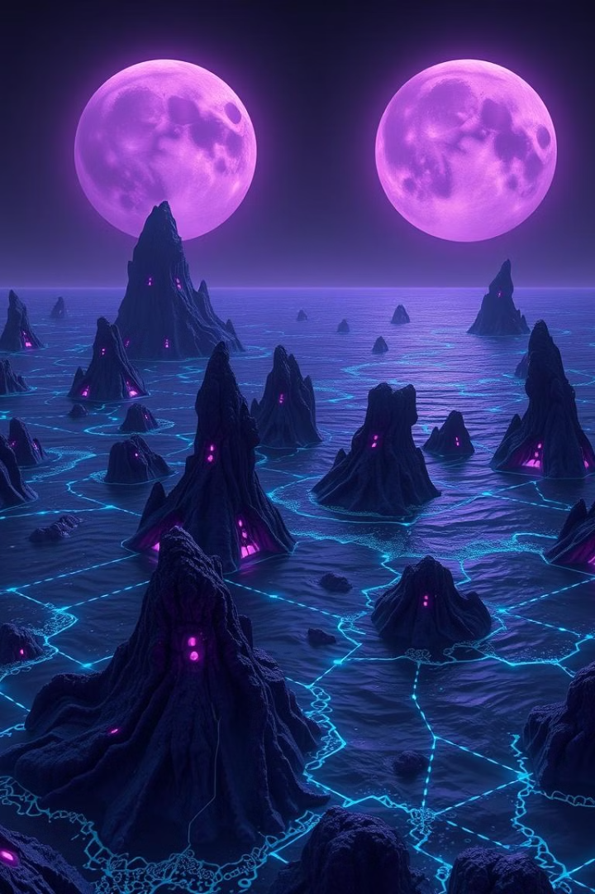
Nexarion: A Chemosynthetic Ocean World
Nexarion, a rare and captivating planet, thrives without sunlight. Its dynamic ecosystem is fueled by the core's energy, tidal waves, and complex chemical reactions that power a vibrant, chemosynthetic marine life.

Slide 2
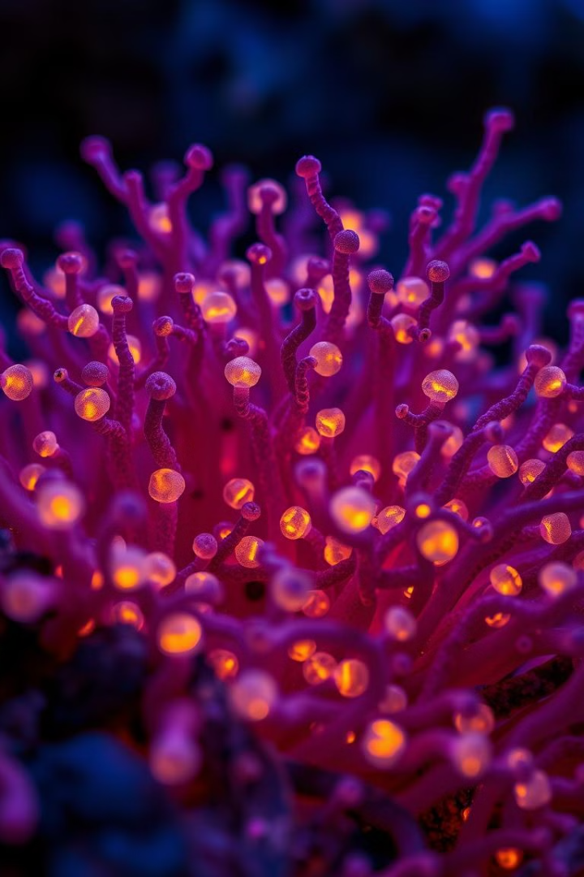
A Microbial Wonderland
1
Unique Microbial Community
Nexarion's microbial life has evolved unique adaptations to thrive in the planet's energy-rich, lightless ocean.
2
Hydrothermal Energy
The planet's core and gravitational forces from its twin moons power a network of hydrothermal vents, fueling chemosynthetic processes.
3
Reaction Algae
Deep-sea algae have evolved to harness the chemical energy of Nexarion's ocean, forming the base of the food chain.

Slide 3
Planetary Composition and Structure
Core Composition
Oceanic Crust
Aquatic Life
Nexarion's core, 2,442 km in diameter, is made up of iron and nickel.
The oceanic crust above the core is composed of felsic rock, rich in light elements like silicon, aluminum, and oxygen.
The diverse, chemosynthetic life on Nexarion exists within the planet's vast, lightless ocean.

Slide 4

Evolutionary Adaptations
Gigantism
The lack of predators and abundant energy sources may allow for the evolution of massive, aquatic organisms on Nexarion.
Resilience
Life on Nexarion must adapt to the harsh conditions of high pressure, extreme temperatures, and a volatile chemical environment.
Metabolic Diversity
Nexarion's unique biochemistries and metabolic pathways may give rise to novel forms of life unlike anything on Earth.
Moon-Influenced Ecosystems
The planet's twin moons create complex tidal zones and influence the dynamics of Nexarion's hydrothermal vents.

Slide 5

A Fascinating Alien World
Chemosynthesis
The primary energy source for Nexarion's ecosystems.
Microbial Life
Unique microbes adapted to the planet's extreme conditions.
Dual Moons
Powerful gravitational forces that shape Nexarion's tides and ecosystems.
Hydrothermal Vents
Crucial energy sources that fuel the planet's chemosynthetic life.

Slide 6

Exploring the Unknown
Discovery
Potential
The first exploration of Nexarion, uncovering its unique chemosynthetic ecosystem.
Nexarion's fascinating alien environment could reveal new insights into the diversity of life in the universe.
1
2
3
Research
In-depth scientific investigation of Nexarion's microbial life, energy sources, and evolutionary adaptations.

Slide 7
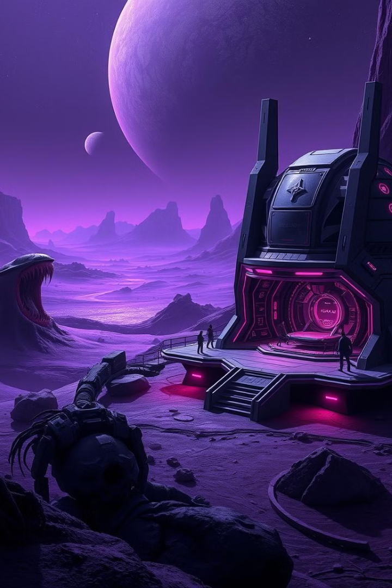
Expanding Our Horizons
Nexarion offers a tantalizing glimpse into the remarkable diversity of life that may exist beyond Earth. As we continue to explore and study this alien world, we expand our understanding of the universe and the boundless possibilities of chemosynthetic ecosystems.

